Slide 1
SVM

Slide 2
Support Vector Machine
In machine learning, Support vector machine(SVM) are supervised learning models with associated learning algorithms that analyze data used for classification and regression analysis. It is mostly used in classification problems. In this algorithm, each data item is plotted as a point in n-dimensional space (where n is number of features), with the value of each feature being the value of a particular coordinate. Then, classification is performed by finding the hyper-plane that best differentiates the two classes.

Slide 3
A Support Vector Machine (SVM) can be imagined as a surface that creates a boundary between points of data plotted in multidimensional that represent examples and their feature values. The goal of a SVM is to create a flat boundary called a hyperplane, which divides the space to create fairly homogeneous partitions on either side. In this way, the SVM learning combines aspects of both the instance-based nearest neighbor learning and the linear regression modeling.

Slide 4
Notable applications include:
Classification of microarray gene expression data in the field of bioinformatics to identify cancer or other genetic diseases
Text categorization such as identification of the language used in a document or the classification of documents by subject matter.
The detection of rare yet important events like combustion engine failure, security breaches, or earthquakes

Slide 5
How SVM works
A Support Vector Machine (SVM) is a discriminative classifier formally defined by a separating hyperplane. In other words, given labeled training data (supervised learning), the algorithm outputs an optimal hyperplane which categorizes new examples. Consider the following scenarios:
Scenario 1:
In this scenario there are three hyper planes called A,B,C. Now the problem is to identify the right hyper-plane which best differentiates the stars and the circles.

Slide 6
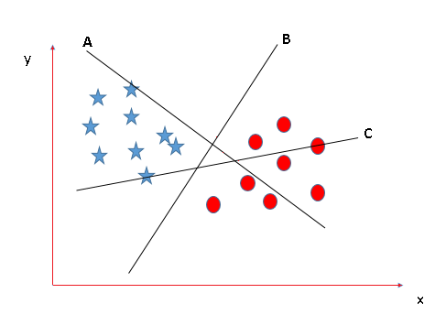

Slide 7
The thumb rule to be known, before finding the right hyper plane, to classify star and circle is that the hyper plane should be selected which segregate two classes better. In this case B classify star and circle better, hence it is right hyper plane.
Scenario 2:
Now take another Scenario where all three planes are segregating classes well. Now the question arises how to identify the right plane in this situation.

Slide 8
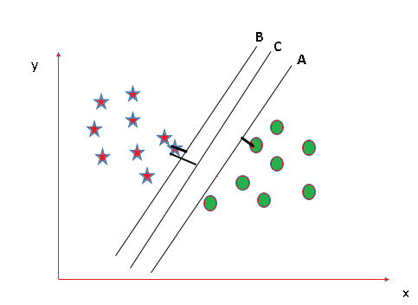

Slide 9
In such scenarios, calculate the margin which is the distance between nearest data point and hyper-plane. The plane having the maximum distance will be considered as the right hyper plane to classify the classes better.
Here C is having the maximum margin and hence it will be considered as right hyper plane.

